Slide 1
Assignment No 1
Write X86 ALP to count, positive and negative numbers from the array
12/29/17

Slide 2
ALP Program Structure
Section .Data (declare Data segment)
; initialized variable Declaration
Section .BSS (declare Block Started by Segment sort of Extra data segment)
; uninitialized variable Declaration
Section .Text (declare Code segment)
Global _start (Entry point for program)
_Start:
;Program code goes here
; semicolon is used to give comment
12/29/17

Slide 3
Section .Data initialized variable Declaration
Syntax
Var_Name Data_Type Variable_Value
Data_Type
DB- Declare/Define Byte (8 bit)
DW- Declare/Define Word (16 bit)
DD- Declare/Define Double Word (32bit)
DQ- Declare/Define Quad Word (64 bit)
Eg. A DB 50
Declare Variable A of type byte with value 50
12/29/17

Slide 4
Section .BSS ; uninitialized variable Declaration
Syntax
Var_Name RES memory_Type Memory Size
RES-Reserve memory
RESB,RESW,RESD,RESQ- Reserve byte,word,double word,quad word memory
Eg.
A resb 50
Declare Variable A and allocate 50 bytes memory for it.
12/29/17

Slide 5
Input/ Read System Call
mov rax,0 ;function to Read(function no compulsory inRAX)
mov rdi, 0 ; read through keyboard
mov rsi, Variable Name
mov rdx, variable length in bytes
syscall ;System call
;Accept input through keyboard and store at variable name for specified variable length
12/29/17

Slide 6
Display/ Write System Call
mov rax,1 ;function to Display(function no compulsory inRAX)
mov rdi, 1 ; Display on monitor
mov rsi, Variable Name
mov rdx, variable length in bytes
syscall ;System call
;Display variable_name contents of specified variable length on monitor
12/29/17

Slide 7
Exit System Call
mov rax, 60 ;function to exit or terminate program (function no compulsory inRAX)
mov rdi, 1/0 ; with status either 0 or 1
syscall ;System call
12/29/17

Slide 8
Declaration of Macro Syntax
%macro macro_Name no_of_ parameters
%1 ;first parameter
%2 ;second parameter
%3 ; third parameter
and so on
%endmacro
Calling of macro--→
macro_Name first parameter, second parameter, ; third parameter
12/29/17

Slide 9
Macro Syntax
%macro read 2 ; ; name of macro , 2 parameters are passed
mov rax,0 ; read syscall
mov rdi,0 ; keyboard
mov rsi,%1 ;variable
mov rdx,%2 ; variable length in bytes
syscall
%endmacro
Calling of macro--→
read MSG, 100;
12/29/17

Slide 10
Procedure Syntax
Procedure declaration and defination (should be after exit code in program)
      Procedure_Name:
      ;code of procedure
      RET
Procedure call in program
call Procedure_Name
12/29/17

Slide 11
Example
      Display:
      ;code of procedure display
      RET
      Calling ->
      Call Display
12/29/17

Slide 12
Difference between macro and procedure
When call macro code is inserted in main program and executed as a program instructions
When call procedure control transfers to procedure definition executes code in procedure location and control returns back to main program
12/29/17

Slide 13
Display Procedure
When you want to display number on screen you need to convert number from hex to ascii format
12/29/17

Slide 14
Algorithm for number display on screen-Hex to Ascii conversion
Take cnt value as 16 into cnt variable; count for 16 digits to display
Move address of “result” variable into rdi.
Rotate left rbx register by 4 bits. ;rbx reg =16 digit number to display
Move bl into al.
And al with 0FH.
Compare al with 09H.
if greater Add 37H into al.
Else Add 30H into al.
12/29/17

Slide 15
Move al into memory location pointed by rdi.
Increment rdi.
Loop the statements till count value becomes zero.
Return from procedure.
12/29/17

Slide 16
display:
;---------------------mov rbx,[num] ;STORE NUMBER IN rBX ----------------------
mov rdi,dispbuff ;POINT rSI TO NUM_BUFFER
;LOAD NUMBER OF DIGITS TO DISPLAY
mov cx,16 ;LOAD COUNT OF ROTATION IN CL
up1:
rol rbx,04 ;ROTATE NUMBER LEFT BY FOUR BITS
mov al,bl ;MOVE LOWER BYTE IN DL
and al,0fh ;MASK UPPER DIGIT OF BYTE IN DL(GET ONLY LSB)
add al,30h ;ADD 30H TO CALCULATE ASCII CODE
cmp al,39h ;COMPARE WITH 39H
jg add_37
;IF grater THAN 39H AKIP ADD 37
add al,30h
Jmp skip1 ;ELSE ADD 30
add_37 : add al,37h
skip1 :mov [rdi],al ;STORE ASCII CODE IN DNUM_BUFFER
inc rdi ;POINT TO NEXT BYTE
dec cx ;DECREMENT THE COUNT OF DIGITS TO DISPLAY
jnz up1 ;IF NOT ZERO JUMP TO REPEAT
dispmsg dispbuff,16 ;CALL TO MACRO
ret
12/29/17

Slide 17
converting number from ascii to HEX
When you accept input from user ,input will store in ascii format in memory. To perform operations on data you need to convert ascii value to Hex format
12/29/17

Slide 18
Algorithm
XOR rbx with rbx to initialize it to 0.
XOR rcx with rcx to initialize it to 0.
XOR rax with rax to initialize it to 0.
Move 16 to rcx register.;number count to convert
Move the address of “num” variable into rsi.
Rotate left rbx by 4 bits.
Move value at memory location pointed by rsi into al.
Compare al with 39H.
12/29/17

Slide 19
If greater Subtract 37H from al.
Else Subtract 30H from al.
Add al into bl.
Increment rsi pointer
Loop the statements till counter becomes zero.
Return from procedure.
12/29/17

Slide 20
Ascii_to_Hex:
mov rbx,0 ;INITIALISE BL BY 0
mov rcx,16 ;INITIALIZE COUNTER AS 16
mov rsi,num_ascii ;POINT ESI TO num_ascii
up2:
rol rbx ,04 ;ROTATE BL TO LEFT
mov al,[rsi] ;MOV NUMBER INTO AL
cmp al,39h ;COMPARE AL(NO IN ASCII) WITH 39H
jg sub_37 ;JUMP IF greater THAN 39h
sub al,30h ; else SUB 30h
Jmp skip2 ;
sub_37 : sub al,37h ;SUB 37 h
skip2 :add rbx,rax ;ADD PREVIOUS NO INTO CURRENT
inc rsi ;INCREMENT ESI
loop up2 ;RPEATE LOOP
ret
12/29/17

Slide 21
To check output of stack in debugging use following commands
Nasm –f elf64 ndp.asm
Ld –o ndp ndp.o
Gdb ndp
Break _start ;you can set any breakpoints in program
Run
Ni ;next instruction execute
Info reg ; system register contents can view
Info float ; stack registers can view starting from R7 to R0
Ni
x/10xh &result ; contents of result variable can check
12/29/17

Slide 22
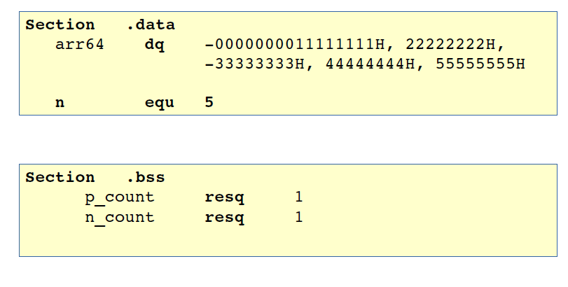
1 : Count +ve & -ve nos
Declare Array by assigning multiple values
12/29/17

Slide 23
Logic for positive /negatiove number checking
To check whether number is positive or negative check sign bit of number.
To check bit we can use BT-bit test instruction
Or shift number to left side by 1 bit so sign bit will shift in carry bit
Or rotate number to left side by 1 bit so sign bit will shift in carry bit
Check carry bit
      If carry bit=1 then number is negative
      Else If carry bit=0 number is positive
12/29/17

Slide 24
Algorithm
Declare array with 64bit numbers,positive count,negative count
Point rsi to array
Take counter as no of elements
Take contents of rsi; first element from array
Check 63rd bit using BT instruction/rotate to left by 1 bit using ROL instruction/shift to left by 1 bit using SHL instruction
Check bit in carry using JC instruction
If carry=1 then increment negative number count
Else increment negative number count
Increment rsi pointer to point next number from array
Repeat cheking procedure till counter will not become zero
Call display procedure to convert positive number count in ascii and display the number
Call display procedure to convert negative number count in ascii and display the number
12/29/17

Slide 25
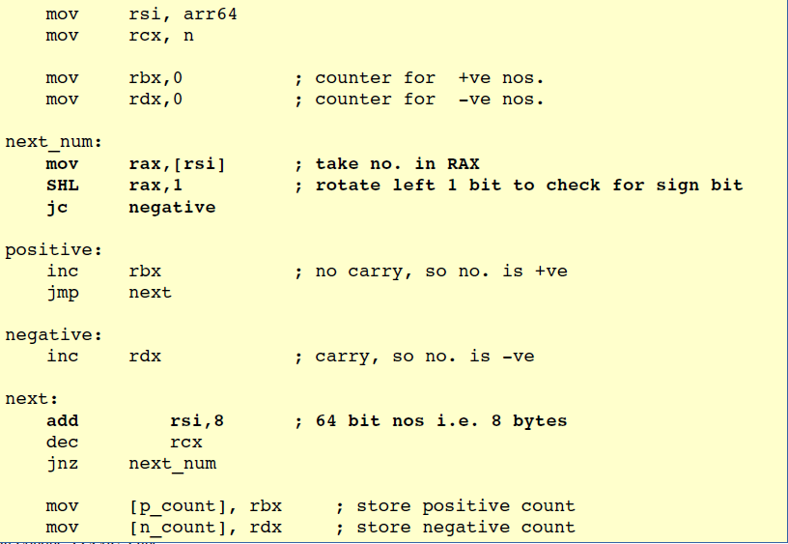
You can use SHL/ROL/BT 63
12/29/17

Slide 26
Assignment no 2
Overlapped and non overlapped Block Transfer (with and Without string instructions)
12/29/17

Slide 27
Block Data transfer
Initialize Array count
Define source Array (Array 1)
Define Destination Array (Array 2) (all Zero)
Display menu using Display macro
Accept Choice from user using Accept macro
If 1 call non overlapped Block Trasnsfer without string instructions Procedure else continue
If 2 call non overlapped Block Trasnsfer with string instructions Procedure else continue
If 3 call overlapped Block Trasnsfer without string instructions Procedure else continue
If 4 call call overlapped Block Trasnsfer with string instructions Procedure else exit
If 5 Use Exit system call to exit
Stop
12/29/17

Slide 28
In Procedures ---→
  Display source and destination addresses and contents before block transfer
  Copy Elements from source array to Destination array till count reaches to zero
  For overlapped select position in destination array to copy elements from array1 to array 2
  Display Source and destination array with Addresses after BT
12/29/17

Slide 29
Non-overlapped BT without string instructons
Point rsi to source
Point rdi to destination
Take counter for number to transfer from source to destination
Take contents of rsi in rax
Mov rax to contents of rdi
Inc rsi and rdi by 8bytes
Decrement counter
Repeat procedure till counter will not become zero
Display source and destination addresses and contents.
12/29/17

Slide 30
Non-overlapped BT with string instructons
Point rsi to source
Point rdi to destination
Take counter in RCX for number to transfer from source to destination
Clear direction flag using CLD instruction; if cld=0 it will set RSI and RDI in auto increment mode. No need to increment pointers explicitly.
Transfer contents from rsi to rdi using string instruction movsb ; movsq instruction automatically transfers contents from rsi to rdi
Repeat procedure till counter will not become zero using REP instruction as a prefix to movsq instruction ; no need to decrement rcx explicitly. Rep instruction loops till rcx=0
Display source and destination addresses and contents.
12/29/17

Slide 31
overlapped BT without string instructons
Section .Data
source dq 1111111111111111h,2222222222222222h,3333333333333333h,0h,0h
Point rsi to source+2 ;point rsi to source block last position
Point rdi to source+4 ; point rdi to destination block last position. 1 element from source is overlapped. You can overlap from any position
Take counter for number to transfer from source to destination
Take contents of rsi in rax
Mov rax to contents of rdi
dec rsi and rdi by 8 bytes
Decrement counter
Repeat procedure till counter will not become zero
Display source and destination addresses and contents.
12/29/17

Slide 32
Non-overlapped BT with string instructons
Point rsi to source+2 ;point rsi to source block last position
Point rdi to source+4 ; point rdi to destination block last position. 1 element from source is overlapped. You can overlap from any position
Take counter in RCX for number to transfer from source to destination
Set direction flag using STD instruction; if std=1 it will set RSI and RDI in auto decrement mode. No need to decrement pointers explicitly.
Transfer contents from rsi to rdi using string instruction movsq ; movsq instruction automatically transfers contents from rsi to rdi
Repeat procedure till counter will not become zero using REP instruction as a prefix to movsq instruction ; no need to decrement rcx explicitly. Rep instruction loops till rcx=0
Display source and destination addresses and contents.
12/29/17

Slide 33
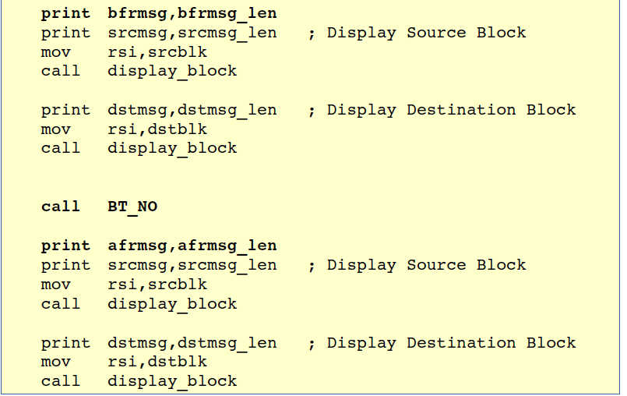
12/29/17

Slide 34
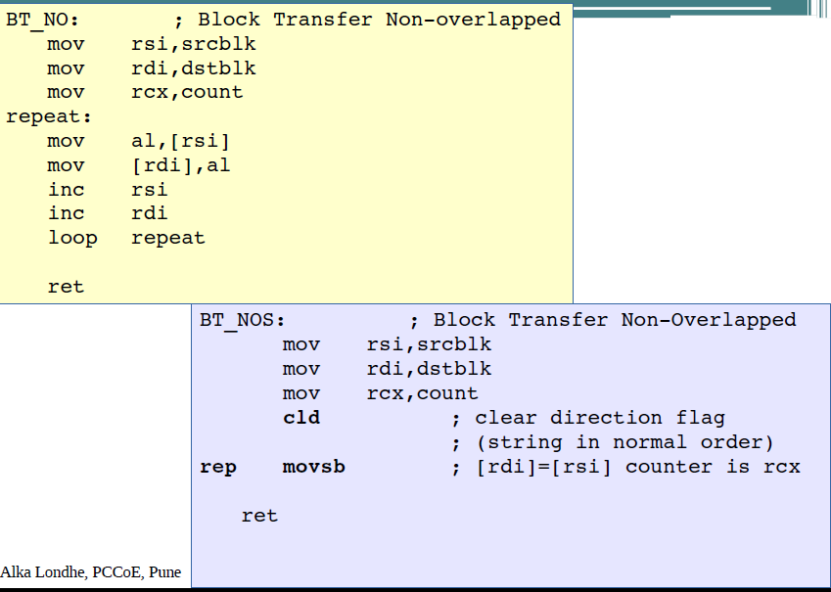
12/29/17

Slide 35
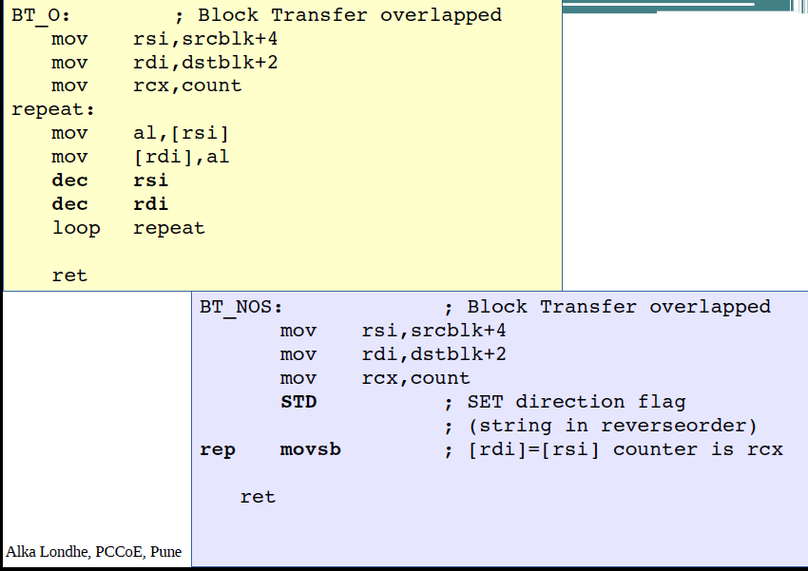
12/29/17

Slide 36
Output
Output should be in format
Address:Contents
12/29/17

Slide 37
Display source address:Contents
Take counter for number of elements to display . In our case it is 3
Take pointer r8 to point source; take address of source in r8 to display
Take r8 in rbx and call display procedure; display address first. In display procedure instead of using rdi pointer use r9 bcz in write system call you need to use rsi and rdi
Display explicit ‘:’
Take contents of r8 in rbx and call display procedure; contents will display here
Increment r8 by 8bytes
Repeat loop till counter will not become zero
12/29/17

Slide 38
Display destination address:Contents
Take counter for number of elements to display . In our case it is 3
Take pointer r8 to point Destination; take address of source in r8 to display
Take r8 in rbx and call display procedure; display address first. In display procedure instead of using rdi pointer use r9 bcz in write system call you need to use rsi and rdi
Display explicit ‘:’
Take contents of r8 in rbx and call display procedure; contents will display here
Increment r8 by 8bytes
Repeat loop till counter will not become zero
12/29/17

Slide 39
Assignment no 3
Hex to BCD and BCD to Hex conversion
12/29/17

Slide 40
number Conversion
Start
Display menu
Accept Choice from user
If choice is 1 call Hex_to_BCD Procedure else continue
If choice is 2 call BCD_to_Hex Procedure else continue
If choice is 3 Use Exit system call to exit
Stop
12/29/17

Slide 41
Hexadecimal to BCD conversion
Conversion of a hexadecimal number can be carried out by dividing number by 10 or 0Ah and displaying remainder in reverse way
12/29/17

Slide 42
H->B
Accept 4 digit hex number from user
Convert number from Ascii to hex by calling conversion procedure
Take number in Accumulator
Divide no by 10 or 0Ah; after division quotient goes in AX and remainder is in DX
Push dx on stack
Increment counter ; to pop dx from stack
Compare quotient with zero. Repeat the procedure till it will not become zero
Pop dx from stack
Convert to ascii and display 1 digit
Repeat pop dx and display procedure till counter will not become zero
12/29/17

Slide 43
BCD to Hexadecimal number
Conversion of BCD number to Hexadecimal number can be carried out by multiplying the previous result by 10 0r 0AH and adding new digit to it
12/29/17

Slide 44
Accept 5 digit bcd number from user
Take rsi pointer to point number; pointing to first number ascii value
Take counter with 5 value
Take zero in Accumulator
Take zero in rdx
Multiply accumulator by 10 or 0Ah
Take first value of rsi in dl register and convert to hex by subtracting 30h
Add this value to accumulator
Increment rsi pointer; now points to 2nd ascii value
Repeat the procedure of taking zero in rdx and multiplying till counter will not become zero
Finally display accumalator contents by calling conversion procedure
12/29/17

Slide 45
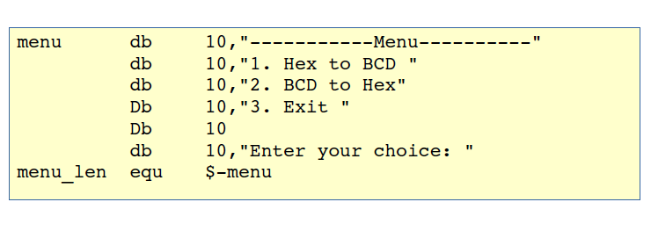
12/29/17

Slide 46
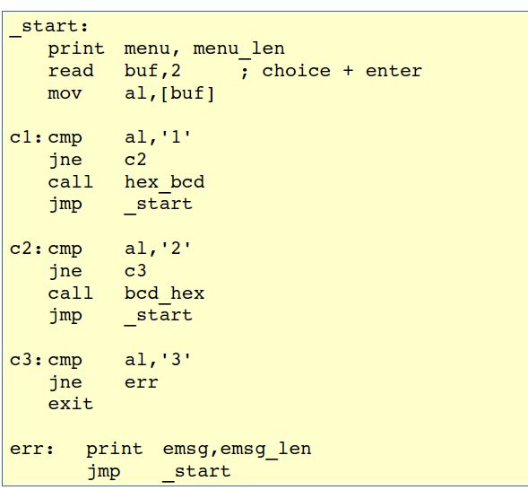
12/29/17

Slide 47
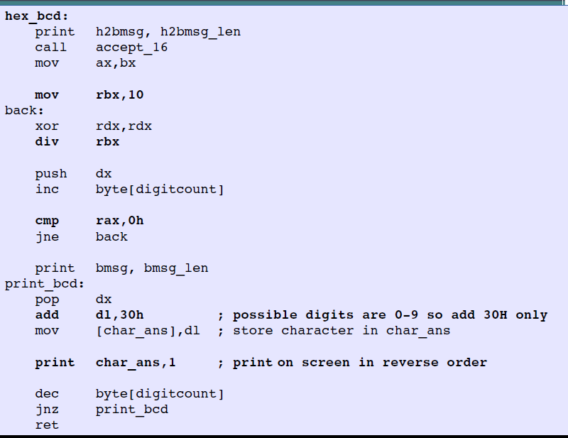
12/29/17

Slide 48
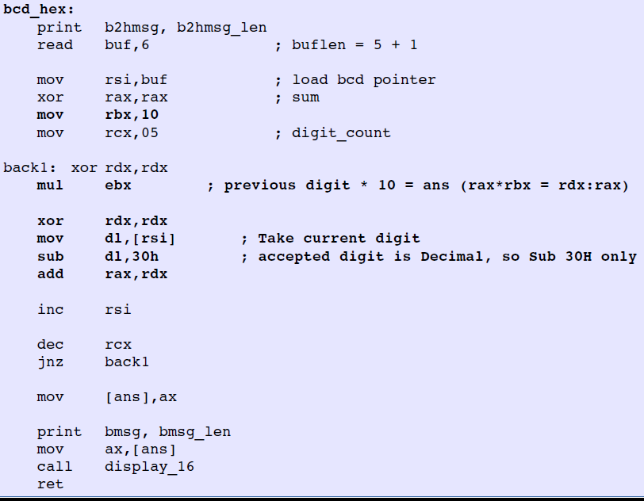
12/29/17

Slide 49
Assignment 4
Write X86 ALP to perform multiplication of two 8- bit hexadecimal numbers.
1. successive addition
2. add and shift method
use of 64-bit registers is expected
12/29/17

Slide 50
Algorithm
Display menu
Accept choice
If 1 call successive addition
Else if 2 call add and shift procedure
Else call exit
12/29/17

Slide 51
successive addition
Accept 2 8-bit numbers
Convert from ascii to hex
Add first number to result variable till second number will not become zero.
; second no is acting as a count
Eg. 02 *03
add 02 three times.
Or add 03 two times
12/29/17

Slide 52
mov al,[num1]
mov bl,[num2]
lp: Add [result],ax
Dec bl
Jnz lp
;convert result and display
12/29/17

Slide 53
Add and Shift
Take num1 in ax;multiplicand ;8bit multiplicand
Take num2 in bx;multiplier; 8bit multiplier
Take count as number of bits; count=8bit
Take result variable of size word with zero value initially
Shift multiplier (num2) right by 1 bit using shr instruction
Check bit using carry;JC instruction can be used
If carry bit =1 then
Shift multiplicand (num1) left by 1 bit and add into result variable
Else if carry bit=0 only shift multiplicand (num1) left by 1 bit no need to add
Repeat procedure till count become zero
12/29/17

Slide 54
mov al,[num1]
mov bl,[num2]
mov [cnt],8
Lp1: Shr bx,1
Jnc lp
Add [result],ax
lp:shl ax,1
Dec [cnt]
Jnz lp1
;convert result and display
12/29/17

Slide 55
Assignment 5 : Far Procedure
Write X86 ALP to find,
a) Number of Blank spaces
b) Number of lines
c) Occurrence of a particular character.
Accept the data from the text file. The text file has to be accessed during Program_1 execution and write FAR PROCEDURES in Program_2 for the rest of the
Processing. Use of PUBLIC and EXTERN directives is mandatory.
12/29/17

Slide 56
NASM assembly program structure
;file.asm
;section .data
;section .bss
;section .text
global _start
_start:
;;
Procedures
12/29/17

Slide 57
If procedures have defined and called in same program ie in same code segment then it is near procedure call
But If procedures have defined called in one program and called in another program ie in other code segment then it is far procedure call
12/29/17

Slide 58
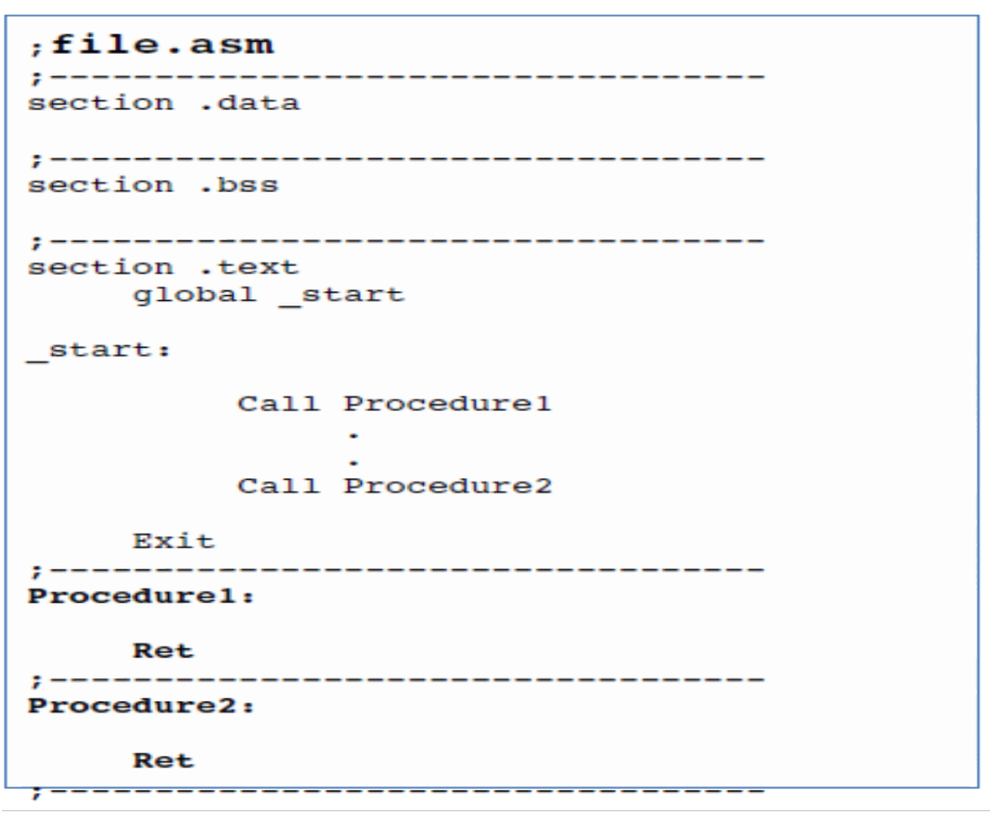
NASM assembly program structure: Near Procedure
12/29/17

Slide 59
To call far procedures or far variables we need to declare them as a public (using global keyword) procedures or variables in defining program.
And declare as a extern using EXTERN keyword in calling program
12/29/17

Slide 60
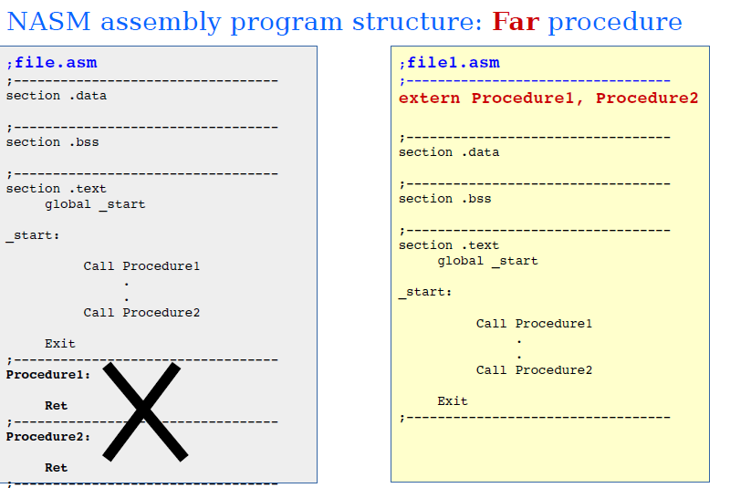
12/29/17

Slide 61
Execution
$ nasm -f elf64 file1.asm
$ nasm –f elf64 file2.asm
$ ld –o file file1.o file2.o
$ ./file
12/29/17

Slide 62
File operations : Open & Close
mov rax,2 ;open
mov rdi,filename ;terminated with '\0'
mov rsi,mode ;0R,1W,2RW
mov rdx,permissions ;rwxrwxrwxo(octal)
Syscall
Returns : rax = filehandle (on success)
rax = 1
(on failure)
12/29/17

Slide 63
SYSTEM CALL OPEN File
mov rax, 2 ; 'open' syscall returns file handle in rax if file opened successfully else returns -1
mov rdi, filename1 ; file name
mov rsi, 2 ; mode of file 0-read,1-write,2 –read and write
mov rdx, 0777o ; permissions set
Syscall
mov [fd_in], rax ;returns file handle in rax
12/29/17

Slide 64
SYSTEM CALL READ File
mov rax, 0 ; ‘Read' syscall
mov rdi, [fd_in] ; file Pointer
mov rsi, Buffer ; variable Buffer for read
mov rdx, length ; len of data want to read
Syscall
;returns length ie number of bytes read in rax register.
12/29/17

Slide 65
SYSTEM CALL
CLOSE File
mov rax,3
mov rdi,[fd_in]
syscall
12/29/17

Slide 66
Algorithm –no of new lines
Accept file name from user
End filename with null char ie 0
Open a file using function 2
Read file in buffer variable using function 0
You will get length of file (number bytes read in rax with EOF)
Dec rax to get actual length
Point rsi to point the buffer
Take contents of rsi in al and compare with 0aH
If equal then increment the new line counter
Else increment rsi pointer
Repeat the procedure till actual length will not become zero
Call display procedure to convert new line counter in ascii and display the number
12/29/17

Slide 67
Algorithm –no of blank spaces
Accept file name from user
End filename with null char ie 0
Open a file using function 2
Read file in buffer variable using function 0
You will get length of file (number bytes read in rax with EOF)
Dec rax to get actual length
Point rsi to point the buffer
Take contents of rsi in al and compare with 20H
If equal then increment the blank space counter
Else increment rsi pointer
Repeat the procedure till actual length will not become zero
Call display procedure to convert blank space counter in ascii and display the number
12/29/17

Slide 68
Algorithm –substring occurance
Accept substring to search ; length1 for 1st and length2 for 2nd string
Point rsi to the buffer
Point rdi to the substring
Take contents of rsi in al and compare with contents of rdi
If equal then increment the rsi and rdi
Decrement length1 and length2
    If match found for 1st char but not for next chars then reinitialise rdi to substring , length2 to default length
    If match found for then increment sustring count and reinitialise rdi to substring , length2 to default length
    Repeat loop till length2 not equal to zero
If not equal increment rsi ,decrement length1
Repeat the procedure till length1 will not become zero
Call display procedure to convert substring count in ascii and display the number
12/29/17

Slide 69
Mov rsi,buf
Mov rcx,[abuf_len]
lp:mov al,[rsi]
Cmp al,20h ;space ascii value 32 (20H)/for new line compare with 0aH
Je incscount
jmp skip
incscount :inc qword[spacecount]
Skip:inc rsi
Dec ,[abuf_len]
Jnz lp
12/29/17

Slide 70
Assignment no 6
check the mode of processor(Real or Protected), then read GDTR, LDTR and IDTR and display the same.
12/29/17

Slide 71
GDTR,IDTR -48 bit in size; 12digits=48 bits
TR, LDTR-16 bit in size
MSW -32 bit in size
They hold 32 bit base address and 16 bit limit
so output format should be
    Base address:limit
12/29/17

Slide 72
Algorithm
To check operating mode of processor we can check PE bit of control word register CR0
CR0 is nothing but Machine Status Word
So read contents of MSW by using SMSW instruction
And check 0th bit by using either ROR/SHR or BT instruction
If carry bit=1 then processor will be in protected mode else processor is in real mode
Display msg accordingly
12/29/17

Slide 73
Take variable to hold all register contents of required size
Store register contents by using store instruction; eg. sgdt [gdtr] ;gdtr is variable
let the contents of GDTR
12345678ABCD ;ABCD is limit
These Contents will store in memory like
CDAB78563412
So to display first point to last byte, take contents ,convert and display
Decrement pointer and repeat procedure
12/29/17

Slide 74
Check Operating mode of processor by reading MSW
smsw eax ;Reading CR0
mov [controlword],eax
ror eax,1 ;Checkin PE bit, if 1=Protected Mode, else Real Mode
jc prmode
disp rmodemsg,rmsg_len
jmp nxt1
prmode:disp pmodemsg,pmsg_len
12/29/17

Slide 75
Display Register contents
sgdt [gdtr]
sldt [ldtr]
sidt [idtr]
Str [tr]
Smsw [msw]
disp gdtmsg,gmsg_len
mov bx,[gdt+4]
call disp_num
mov bx,[gdt+2]
call disp_num
disp colmsg,1
mov bx,[gdt]
call disp_num
12/29/17

Slide 76
Assignment 7 : Bubble Sort
Write X86 ALP -To sort the list of integers in ascending / descending order using bubble sort. Read the input from the text file and write the sorted data back to the same text file.
12/29/17

Slide 77
Accept file name from user;
Dec rax; getting length in rax with enter key
End filename with null car; mov [filename+rax],0
Open file using function 2
Read file in buff using function 0; rax will hold actual length of file including EOF so decrement rax
Buff will hold ascii values of file contents
    Eg . Data .txt contain
    1
    2
    3
    4
    5
Then buff will contain
310A320A330A340A350A
12/29/17

Slide 78
We want to perform bubble sort so we need to find array contents without enter key ascii value so,
Point rsi to buff and rdi to another variable array
Take contents of rsi transfer to contents of rdi
Increment rdi to hold second value
Increment rsi two times to point second value
Repeat procedure till actual length will not become zero
Perform bubble sort operation on array
Write contents using function 1 in same file
12/29/17

Slide 79
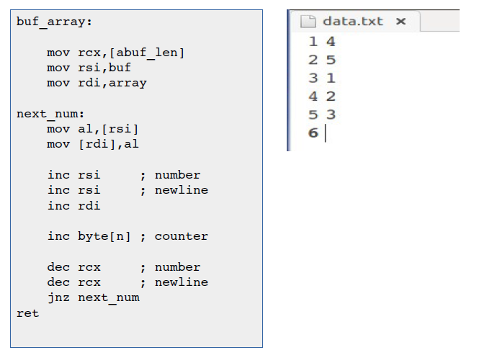
12/29/17

Slide 80
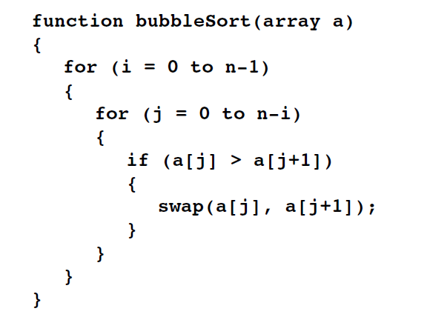
12/29/17

Slide 81
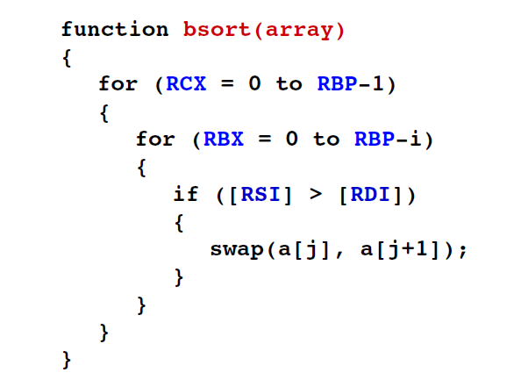
12/29/17

Slide 82
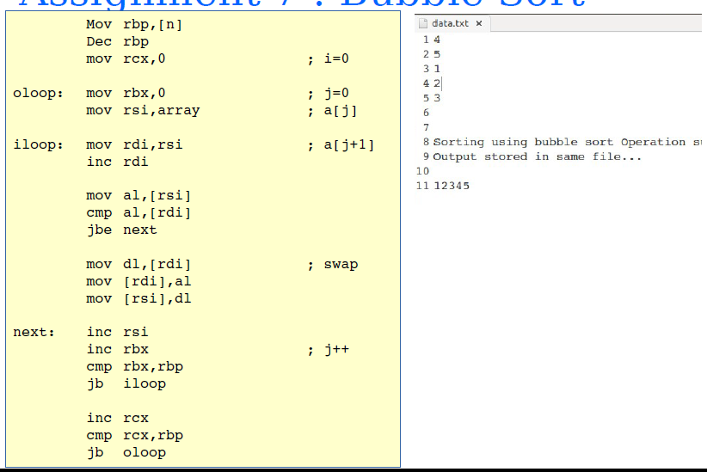
12/29/17

Slide 83
Assignment 8
DOS Commands
Algorithm
1.Accept Filenames from Command line.
2.Display MENU:-
1.TYPE
2.COPY
3.DEL
3.Procedure for TYPE command
4.Procedure for COPE command
5.Procedure for DELETE command
6.EXIT
12/29/17

Slide 84
Run the program and give arguments to exe file
  Nasm –f elf64 a.asm
  Ld –o a a.o
  ./a data.txt
  Data.txt is command line argument to exe file a
  It will store in stack
  Structure of stack is given in next slide
  top of stack hold argument count in RCX
  Next position hold address of executable file path in rsi
  Next position hold address of first argument in rsi
  Next position hold address of second argument in rsi
  Next position hold address of third argument in rsi
  And so on
12/29/17

Slide 85
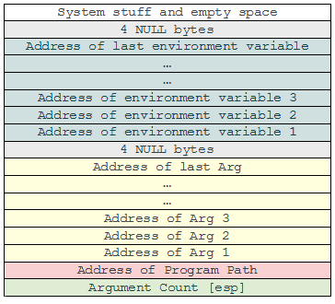
Stack When You Run Program
12/29/17

Slide 86
In our example RCX=1 only one argument for data.txt
Rsi =address of ./a
Rsi=address of data.txt
    Rsi will point to d
    Rsi+1 will point to a
    Rsi+2 will point to t
    Rsi+3 will point to a
    And so on till 0;null char
12/29/17

Slide 87
Algorithm to read filename
Point rdi to variable to hold filename given as argument
pop argument count ie rcx
Pop rsi ;add of ./a
Pop rsi; add of data.txt
Take contents of rsi in al
And transfer to rdi
Increment rsi and rdi pointers
Repeat procedure till null char ie. [rsi]=0
12/29/17

Slide 88
How to Fetch Command line Argument
mov rcx,00
pop rcx ;Argument count
pop rsi ; get pointer for executeable file path
pop rsi ; get pointer for arg1
Mov rdi, filename1 ;Filename1 variable to store arg1
;read in filename1 var
Lp: Mov al,[rsi]
Mov [rdi],al
Inc rsi
Inc rdi
Cmp al,0
Jne lp
12/29/17

Slide 89
SYSTEM CALL
OPEN File
mov rax, 2 ; 'open' syscall
mov rdi, filename1 ; file name
mov rsi, 2 ; mode of file 0-read,1-write,2 –read and write
mov rdx, 0777o ; permissions set
Syscall
mov [fd_in], rax ;returns file handle in rax
12/29/17

Slide 90
SYSTEM CALL
READ File
mov rax, 0 ; ‘Read' syscall
mov rdi, [fd_in] ; file Pointer
mov rsi, Buffer ; variable Buffer for read
mov rdx, length ; len of data want to read
Syscall
12/29/17

Slide 91
SYSTEM CALL
WRITE File
mov rax, 01 ; ‘Write' syscall
mov rdi, [fd_in] ; file Pointer
mov rsi, Buffer ; Buffer for write
mov rdx, length ; len of data want to read
Syscall
12/29/17

Slide 92
SYSTEM CALL
DELETE File
mov rax,87
mov rdi,Fname
syscall
12/29/17

Slide 93
SYSTEM CALL
CLOSE File
mov rax,3
mov rdi,[fd_in]
syscall
12/29/17

Slide 94
Algorithm -type
Take file name as argument
Open file using function 2
Read file in buff using function 0
You will get length in rax; including EOF
Decrement length rax
Write file contents( read in buff) using function 1 on monitor;
Close file
12/29/17

Slide 95
Algorithm -delete
Take file name as argument
Delete file using function 87
end
12/29/17

Slide 96
Algorithm -copy
Take two file names as argument
Open file1 using function 2
Open file2 using function 2
Read file1 in buff using function 0
You will get length in rax; including EOF
Decrement length rax
Write file1 contents( read in buff) using function 1 in file 2
Close file1
Close file 2
12/29/17

Slide 97
type
mov rax,2 ;open 1st file
mov rdi,file1
mov rsi,2
mov rdx,0777o
syscall
b2:cmp rax,-1d
je displayerror
mov [fhandle1],rax ;copy the fhandle from the rax
;similarly open second file for copy operation
12/29/17

Slide 98
mov rax,0 ;read the 1st file
mov rdi,[fhandle1]
mov rsi,buffer
mov rdx,bufferlen
Syscall
Dec rax
Mov [actual_len],rax
mov rax,1 ;write the 1st file on monitor
mov rdi,1
mov rsi,buffer
mov rdx, [actual_len]
Syscall
12/29/17

Slide 99
delete
mov rax,87 ;function to delete file
mov rdi,filename1
Syscall
12/29/17

Slide 100
copy
Open first file ,second file
Read first file in buffer
mov rax,1 ;write the 1st file in second file
mov rdi,[fhandle2]
mov rsi,buffer
mov rdx, [actual_len]
Syscall
12/29/17

Slide 101
Assignment no 9
Calculate Factorial of number using Recursion
12/29/17

Slide 102
Factorial Logic
Trace of a call to Factorial: int z = factorial(4)
factorial(4)=
4 * factorial(3)
Returns 3*2 = 6 and terminates
We can’t evaluate 3! directly, so we call factorial (3)
factorial(3)=
3 * factorial(2)
Returns 2*1 =2
and terminates
We can’t evaluate 2! Directly, so we call factorial(2)
factorial(2)=
2 * factorial(1)
factorial(1)=
1 * factorial(0)
Returns 1*1
and terminates
We can’t evaluate 1! directly – call factorial(1)
We must call factorial(0)
BASE CASE:
factorial(0)= 1
Returns 1
and terminates
finally, factorial(4) computes 4*6, returns 24, and terminates
12/29/17
Notes:
Ideas to present:
Call stack – each call gets different set of parameters
“wish-for” example. If I only had a function to compute 3!, I could invoke it, multiply the results by 4, and I would be done. The Wish-for function is really the recursive call, and we really don’t need to worry about how it works, just so long as the base case and the recurrence relationships are correct.
Show that T(n) = K +T(n-1), so the time complexity of this function is also O(n),
BUT the function calls have overhead, and so recursion can be time-consuming.

Slide 103
Algorithm
Read value as a command line argument; you will get ascii value in stack
Pop arg cnt,rsi,rsi
Take contents from rsi and convert in hex
Call factorial function recursively
Display factorial
12/29/17

Slide 104
factorial function
Push number on stack
Compare number with 1
If not 1 then decrement number and call procedure recursively
if it is 1
    Pop number from stack
    Multiply with result variable
    Return from procedure
12/29/17

Slide 105
ASM PROGRAM
;get number from command argument in rax
mov [no1],rax
call factorial
Xor rax,rax
mov rax, qword[result]
call display ; displays a 8 digit hex number in rax
12/29/17

Slide 106
Factorial Recursion
factorial:
push rcx ;rcx holding number
cmp rcx,01 ;compare number with 1 .if it is not one then recursively decrement and store on stack
jne continue
jmp exit2
continue :dec rcx
call factorial
exit2:pop rcx ;pop number from stack
mov rax,rcx
mul qword[result] ;multiply with result var
mov qword[result],rax
ret
12/29/17

Slide 107
Assignment no 10
80387 mean ,Variance ,Deviation
12/29/17

Slide 108
To check output of stack in debugging use following commands
Nasm –f elf64 ndp.asm
Ld –o ndp ndp.o
Gdb ndp
Break _start ;you can set any breakpoints in program
Run
Ni ;next instruction execute
Info reg ; system register contents can view
Info float ; stack registers can view starting from R7 to R0
Ni
x/10xh &result ; contents of result variable can check
12/29/17

Slide 109
Algorithm
Declare array to calculate mean
eg. array dd 1.0,1.0,1.0,1.1,1.5
Take count of numbers; =5
Initialize ndp wit FINIT instruction
Load zero on top of stack in ndp using FLDZ instruction
Take pointer rsi to point to array first element
Add first value in ST(0)
Increment pointer by 4 bytes; as data is of double word type
Repeat procedure till counter =0
Divide by count to top of stack; st0=mean in our case it may be 1.123……
Store mean in variable
12/29/17

Slide 110
For Display Output
Decide how many decimal points you want to deisplay lets 2 decimal points u want to display
So, Multiply by 100 to top of stack; decimal point will shift by 2 positions right by this mul operation; in our case it will something like 112.3…….
Store BCD of stack top in variable.; in our case it will 00000…..112
In memory this number will store like this 80bit value-
    12010000000000000000
12/29/17

Slide 111
;remember 80 bit=10 bytes 1byte=2digits,10bytes=20digits to display
Now point r8 to last position ie 10th byte
Take counter of 9 to display integer part
Take contents of r8 ;2 digits ; first two zeros in first loop and so on
Convert and display 2 digits
Decrement r8 to point 9th byte
Repeat display procedure till counter will not become zero
    000000000000000001
Display explicit decimal point ; 000000000000000001.
Take contents of r8 ;2 digits ; r8 is pointing to 0th byte
Convert and display 2 digits ;000000000000000001.12
12/29/17

Slide 112
Mean operation
finit ;initialize Floating Point Unit
fldz ;load zero on ST0-ST0=0
mov rsi,array ;point rsi to array First element
xor rcx,rcx ;make rcx 0
mov cx,[datacnt] ;load counter
lp: fadd dword[rsi] ;add first element of array
Add rsi,4 ; INCREMENT pointer by 4 as data is of size double word
loop lp ;keep adding till counter not zero
;top of stack is now holding addition of all 5 values in our case
fidiv word[count] ;divide by number count
fst dword[mean] ; store result in variable mean bcz we need it for variance
12/29/17

Slide 113
Display Result
FIMUL [hundred] ;want to display 2 decimal points so multiply by 100 to st0
FBST tword[result] ;store mean from st0 to result variable as BCD value
xor rcx,rcx ;make rcx 0
mov rcx,09h ;load counter by 9
mov r8,result +9 ;point r8 to base of 10th byte digit ;after that we ;print decimal pt.
up2:
mov bl,[r8] ;mov current byte pointed by r8 to bl
call display ;convert it to ASCII and display 2 digits
dec r8 ;decrement pointer
loop up2 ;repeat steps till rcx is not zero
display decpt,1 ;diaply decimal point after 8digits
mov bl,[r8] ;display remaining two digits
call display ;convert it to ASCII and display 2 digits
12/29/17

Slide 114
Like this calculate variance,deviation and display the result
12/29/17

Slide 115
Assignment no 11
Roots of quadratic equation 80387
12/29/17

Slide 116
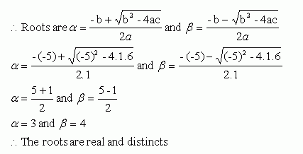
Formula
12/29/17

Slide 117
ALgorithm
Declare a,b,c,four,two with values
Initialize stack
Load b on top of stack ;st0 =b
Multiply b with top of stack
Load four on top of stack ; b2 will shift to st1 st0=4,st1=b2
Multiply a with top of stack ; st0=4a
Multiply c with top of stack ; st0=4ac
Substract 4ac from b2 ;st0=b2-4ac
Compare b2-4ac is equal to zero using either FCOM or FTST instruction; this comparison sets condition bits in status word register
Store status word register in any register using FSTSW AX
Store higher part of this register in flag register using SAHF
12/29/17

Slide 118
Use jump instruction to check value either JL,JB
If this value is less than zero then display massage complex root
Else continue to find root value
Take squre root of top of stack; st0=b2-4ac using FSQRT instruction
Store this value in variasble bcz we have to calculate 2 roots
Substract b from st0; st0=st0-b
Divide st0 by 2
Divide st0 by a
Now st0 is holding first root
Display the root using display387 procedure
Similarly calculate second root and display
12/29/17

Slide 119
For Display Output
Decide how many decimal points you want to deisplay lets 2 decimal points u want to display
So, Multiply by 100 to top of stack; decimal point will shift by 2 positions right by this mul operation; let it will something like 112.3…….
Store BCD of stack top in variable.; in our case it will 00000…..112
In memory this number will store like this 80bit value-
    12010000000000000000
12/29/17

Slide 120
;remember 80 bit=10 bytes 1byte=2digits,10bytes=20digits to display
Now point r8 to last position ie 10th byte
Take counter of 9 to display integer part
Take contents of r8 ;2 digits ; first two zeros in first loop and so on
Convert and display 2 digits
Decrement r8 to point 9th byte
Repeat display procedure till counter will not become zero
    000000000000000001
Display explicit decimal point ; 000000000000000001.
Take contents of r8 ;2 digits ; r8 is pointing to 0th byte
Convert and display 2 digits ;000000000000000001.12
12/29/17

Slide 121
Display Result
FIMUL [hundred] ;want to display 2 decimal points so multiply by 100 to st0
FBST tword[result] ;store mean from st0 to result variable as BCD value
xor rcx,rcx ;make rcx 0
mov rcx,09h ;load counter by 9
mov r8,result +9 ;point r8 to base of 10th byte digit ;after that we ;print decimal pt.
up2:
mov bl,[r8] ;mov current byte pointed by r8 to bl
call display ;convert it to ASCII and display 2 digits
dec r8 ;decrement pointer
loop up2 ;repeat steps till rcx is not zero
display decpt,1 ;diaply decimal point after 8digits
mov bl,[r8] ;display remaining two digits
call display ;convert it to ASCII and display 2 digits
12/29/17

Slide 122
Assignment no 12
12/29/17

Slide 123
Commands for 16 bit programming
TSR programs implement in TASM- 16bit programming in windows
Use following commands
  Edit filname.asm ;open file
  Tasm filename.asm ;assemble file
  Tlink filename/t ;link and load file(u can use filename.obj )
  Filename ; execute filename(u can use use filename.exe)
12/29/17

Slide 124
TSR: Terminate but Stay Resident
Transient programs: .EXE, .COM
TSR programs: .COM
  Can be loaded after DOS is loaded,
  Stay in the memory, even if they are not active on your screen,
  They appear to exit, but remain in the memory to perform tasks in the background,
12/29/17

Slide 125
Structure of TSR
Divided into three sections:
  Data area
  Resident routine and
  Initialisation routine
12/29/17

Slide 126
Resident Routine
Portion of program which will be made resident in the memory to perform specified task.
During execution of specified task original register contents may get change so these contents must be preserved and again loaded before calling original interrupt service routine
12/29/17

Slide 127
MYINT08:
PUSH AX
PUSH BX ;We can use or
PUSH CX
PUSH DX
PUSH SI
PUSH DI
PUSH SI
PUSH DS
PUSH ES
;// Specified task
POP AX
POP BX ;We can use or
POP CX
POP DX POP SI
POP DI POP SI POP DS
POP ES
JMP CS:SAVEINT08
12/29/17

Slide 128
Initialization routine
It execute only once.
When executed reserves memory block where resident program resides.
Resident program may get executed periodically or on demand. For this interrupt capture process is used.
In that process ,modify the content of IVT entries & contain new address pointing to resident program.
Save original content of IVT so that after resident program execution control transfer to original ISR
12/29/17

Slide 129
Initialization Routine
Does the preliminary work to make resident routine stay resident in the memory,
It executes only once,
It performs following steps
  1) Get the original address of specified interrupt from IVT and save it
  2) Store the address of resident program in the IVT in place of original address,
  3) Calculate the size of the resident routine including Data area and PSP. Reserve the memory area of this size and make the program resident
12/29/17

Slide 130
Initialization Routine Continued . . .
To perform these three steps we use three INT 21H functions
  Function 35H: Get Interrupt Address
    Call with AH=35H, AL= int #
    Returns vector address in ES:BX
  Function 25H: Set Interrupt Address
    Call with AH=25H, AL=int # , DS:DX= segment:offset of interrupt handling routine
  Function 31H: Make program resident
12/29/17

Slide 131
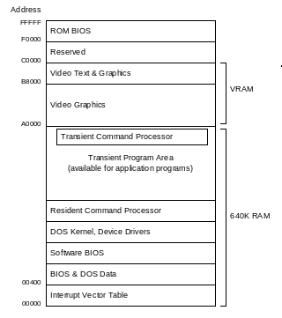
Terminate But Stay Resident (TSR)

Slide 132
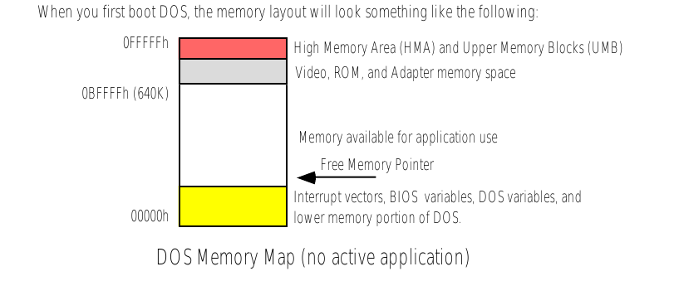
12/29/17

Slide 133
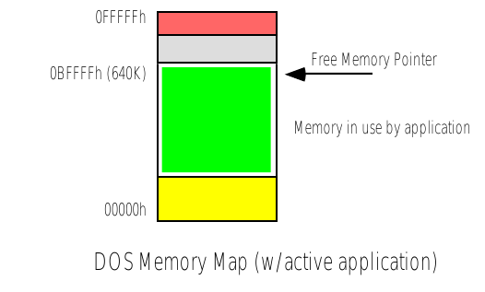
12/29/17

Slide 134
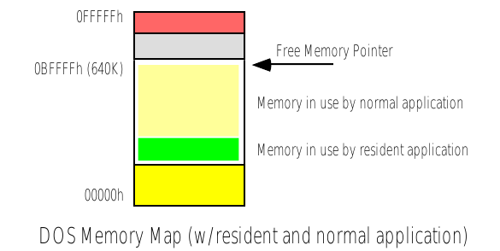
12/29/17

Slide 135
WHY .model tiny ?
As it is .com pgm
Consist of only one segment ie code segment so model of memory is .model tiny
12/29/17

Slide 136
WHY ORG 0100h
.COM program starts at the end of PSP
PSP location is from 00H –FFH
So after that code starts at 0100h
12/29/17

Slide 137
Why jmp to transient section
As resident is always in memory but inactive state
So to activate it transient section to b activated first
12/29/17

Slide 138
Algorithm of initialisation routine
Clear interrupt flag to avoid any hardware interrupt during the process of
initialisation,
Read the original vector address entry and store is in data area
Set the vector address to our interrupt service routine
Set interrupt flag
Terminate and make it resident
ATTRIBUTE BYTE BL R G B I R G B
BACKGROUND FOREGROUND
FORMULA TO CALCULATE OFFSET IN VIDEO RAM USING X,Y CO-ORDINATES
= [(Y * 80)+X]*2
12/29/17

Slide 139
Algorithm of program: (Resident Routine)
1. ORG 100H
2. Unconditionally jump to initialisation routine
3. Reserve memory loctations to store the registers and original vector address
4. Store the registers temporarily
5. Read time
6. Initialise base address(B800h) of page-0 of video RAM in ES and offset(3984h) of a
location where we want to display the RTC,
7. Display HH:MM:SS
8. Restore the original register contents
9. Call the original interrupt service procedure
12/29/17

Slide 140
INIT: CLI
MOV AH,35H ;GET VECTOR
MOV AL,08H ;OF TYPE 08
INT 21H ;WHICH RETURNS VECTOR ADDRESS IN ES:BX
MOV WORD PTR SAVEINT08,BX
MOV WORD PTR SAVEINT08+2,ES
MOV AH,25H ;SET VECTOR
MOV AL,08H ;OF TYPE 08
LEA DX,MYINT08 ;ENTRY POINT OF MY ISR STORED IN DS:DX
INT 21H
MOV AH,31H ;TERMINATE AND MAKE RESIDENT
LEA DX,INIT ;SIZE OF MEMORY BLOCK
STI ;SET IF
INT 21H
END START
12/29/17

Slide 141
RTC with Tone
Reading Real Time Clock
MOV AH,02H ;READ CLOCK. RETURNS CH=HH, CL=MM, DH=SS IN BCD
INT 1AH
Displaying on screen (Resolution 80-by-25 Text Mode)
MOV DI,3984 ;OFFSET WHERE WE WANT TO DISPLAY HH:MM:SS
-
MOV ES:[DI],AX
Accessing System Speaker: (Port 61H)
IN AL,61H
OR AL,00000011B
OUT 61H, AL
12/29/17

Slide 142
To generate frequency tone
communicate with speaker controller using IN and OUT inst. steps in generating beep
Send the value 182 to port 43h. This sets up the speaker.
Send the frequency number to port 42h. Since this is an 8-bit port, you must use two OUT instructions to do this. Send the least significant byte first, then the most significant byte.
12/29/17

Slide 143
To start the beep, bits 1 and 0 of port 61h must be set to 1. Since the other bits of port 61h have other uses, they must not be modified. Therefore, you must use an IN instruction first to get the value from the port, then do an OR to set the two bits, then use an OUT instruction to send the new value to the port.
Pause for the duration of the beep.
Turn off the beep by resetting bits 1 and 0 of port 61h to 0. Remember that since the other bits of this port must not be modified, you must read the value, set just bits 1 and 0 to 0, then output the new value.
12/29/17

Slide 144
mov al, 182 ; Prepare the speaker for the note.
out 43h, al
mov ax, 9121 ; Frequency number (in decimal) ; for C.
out 42h, al ; Output low byte.
mov al, ah ; Output high byte.
out 42h, al
in al, 61h ; Turn on note (get value from ; port 61h).
or al, 00000011b ; Set bits 1 and 0.
out 61h, al ; Send new value.
mov bx, 25 ; Pause for duration of note.
Pause1: mov cx, 65535
Pause2: dec cx
jne pause2
dec bx
jne pause1
in al, 61h ; Turn off note (get value from ; port 61h).
and al, 11111100b ; Reset bits 1 and 0.
out 61h, al
12/29/17

